Slide 1
How online privacy concern affects decision-making of Internet users
Ivan-Damir Anić, Jelena Budak,
Edo Rajh, Vedran Recher,
Vatroslav Škare, Bruno Škrinjarić

Slide 2
Introduction
on online privacy and decision-making
Interest in different aspects of behavior in digital age, and especially in decision making in the online environment
Are Internet users concerned about privacy intrusion and what do they do when facing online privacy issues?
Do people in different societal groups share similar attitudes about online privacy, and if not what variables sets them apart?
What decisions do Internet-users take accordingly?
How individual judgements about online privacy change personal behavior in the ubiquitous online environment?

Slide 3
Conceptual model
We have identified a lack of a comprehensive and integrated model that would consolidate streams of research in the online privacy concern field
Online privacy involves the rights and interests of an individual concerning the processing, of the personal information (Gellman&Dickson, 2011)
Online privacy literature deals with the problem of how to mesure privacy concern of Internet users, which variables to include and therefore model is not purely an economic one but socio-economic (Li, 2011)
The level of online privacy concern shapes our behavior on the Internet and beyond
  Consumers become more alert, altering protective behavior
  Influence adoption of new technologies
  Future usage of Internet and other decisions

Slide 4
Extended model of online privacy concern
ANTECEDENTS | CENTRAL VARIABLE | CONSEQUENCES
Culture/traditional values (TRAD_VAL) | Online privacy concern (OPC) | BEHAVIOR technical protection (PB_PROT) fabrication of data (PB_FAB) withholding the data, sustaining (PB_SUST)
Social trust in institutions and general trust in people (ST)
 |  | ATTITUDES share personal information online (SH) Intention to adopt new technologies (NEWT)
Computer anxiety (CA)
Need for privacy/belief in privacy rights (NFP)
 |  | Perceived benefits of using the Internet (BNF)
Regulation/protection of online privacy (REG)

Slide 5
Survey methodology
The scales from the literature were adopted in developing the questionnaire
Survey was conducted in early 2016 at the representative sample of Internet users in Croatia
Data were collected by CATI method
The net sample consists of 2060 Internet users aged 18 or older

Slide 6
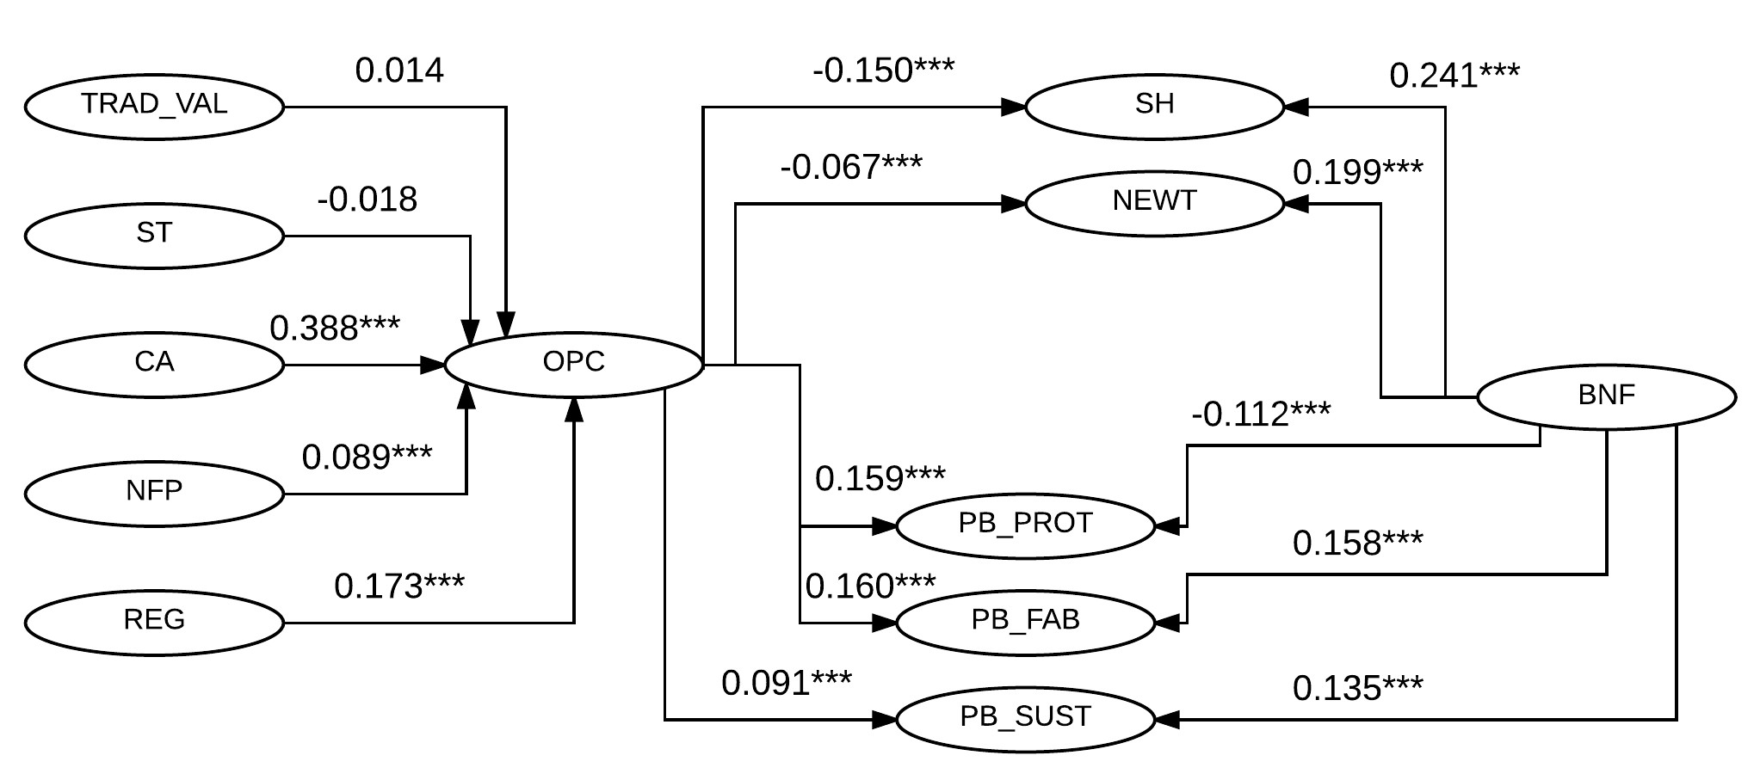
Estimation results
SEM-PLS applied
Path coefficients of the structural model

Slide 7
Results and discussion
Among variables included in the model as antecedents,
Computer anxiety seems to have the largest positive impact on level of online privacy concern,
followed by perceived low quality of the regulatory framework
respondents’s belief in privacy rights i.e. need for privacy increases individual-s privacy concern.
traditional personal values and social trust do not have a significant impact on online privacy concern.

Slide 8
Results and discussion cont
On the consequences side of the model
online privacy concern has the largest impact on active protection, fabrication and sharing personal information on the Internet.
there is a strong and significant positive relation between online privacy conern and protective behavior.
Internet users who are more concerned about their online privacy would change their intentions to share personal information and intentions to adopt new techologies.
The research shows that, on average, perceived benefits of using the Internet outweighs potential associated costs with privacy concern of people..

Slide 9
Conclusion
The level of online privacy concern shapes our behavior on the Internet
This research unveils the trade-off between privacy concern and perceived benefits of using the Internet
The online privacy concern might influence adoption of new technologies and other innovations, future usage of online services, and other far reaching decisions
Therefore findings may be useful for practitioners as well, notably in helping companies to develop business strategies and regulators to better frame privacy policy.

Slide 10
Thank you for your attention!
jbudak@eizg.hr
This work has been fully supported by Croatian Science Foundation under the project 7913.

