Slide 1

DEVELOPMENT IN DIGITAL AND POST-TRANSITION ERA: ONLINE PRIVACY CONCERN APPROACH
Vedran Recher, Jelena Budak & Edo Rajh
Institute of Economics, Zagreb
REDETE, Graz 22.-24.10. 2015

Slide 2
‘’If this is the age of information, then privacy is the issue of our times.’’
Acquisti, Brandimarte & Loewenstein (2015)

Slide 3
Introduction
increasing importance of online privacy
over half of Internet users in Europe feel uncomfortable with profiling on the Internet (EC, 2011)
business climate, reforms, business policies
determinants of OPC → connection with development in post-transition?

Slide 4
Western Balkan countries
Croatia, FYR Macedonia, Serbia, Bosnia and Herzegovina are analysed
differences in the EU accession path → EU regulations implemented in the course of the accession

Slide 5
Survey data, n=2006
 | % |  | %
Gender |  | Country
Male | 49.7 | Bosnia and Herzegovina | 24.9
Female | 50.3 | Croatia | 25.2
Age |  | FYR of Macedonia | 24.9
18-34 | 31.5 | Serbia | 24.9
35-54 | 37.4 | Internet usage
55-70 | 31.1 | Yes | 64.2
Education |  | No | 35.8
Primary school | 14.2
Secondary school | 59.9
University and higher education | 25.9
No answer | 0.1

Slide 6
PRICON index
Country | Online privacy concern
 | PRICON index
Croatia | 4.26
FYR of Macedonia | 4.10
Serbia | 3.91
Bosnia and Herzegovina | 3.57
Information I send over the internet (e-mail, Facebook and other) could be misused.
The usage of computers and ICT increases the possibility of personal data manipulation.
I am concerned about the volume of personal information and data stored on computers that might be misused.

Slide 7
ANOVA results
Independent variable | PRICON mean value | St. dev. | N | ANOVA
Education |  |  |  | F=81.40 p=0.00
Primary school or less | 3.43 | 0.83 | 285
Secondary school | 4.01 | 0.76 | 1201
University and higher education | 4.12 | 0.79 | 519
Age |  |  |  | F=11.85 p=0.00
18-34 | 4.00 | 0.77 | 632
35-54 | 4.03 | 0.79 | 751
55-70 | 3.83 | 0.85 | 623
Country |  |  |  | F=76.89 p=0.00
Croatia | 4.26 | 0.69 | 506
Serbia | 3.91 | 0.81 | 500
Bosnia and Herzegovina | 3.57 | 0.86 | 500
FYR of Macedonia | 4.10 | 0.69 | 500

Slide 8
Results (2)
that there are no statistically significant differences in online privacy concern between males and females
statistically significant differences in online privacy concern by internet usage groups

Slide 9
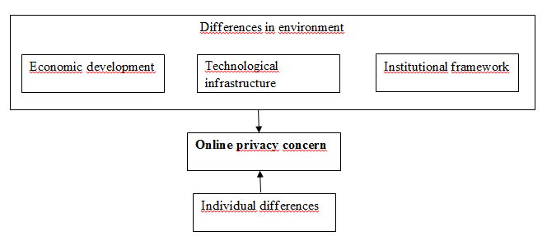
Contextualizing OPC and development

Slide 10
Conceptual framework
Country | Online privacy concern | Economic development | Technological level achieved |  |  | Institutional set-up
 | PRICON index | GDP p.c. | Availability of latest technologies | Internet users | Broadband | EU status | Political rights | Civil liberties
Croatia | 4.26 | 20,182 | 5.4 | 60.3 | 18.3 | Member state | 1 | 2
FYR of Macedonia | 4.10 | 11,268 | 4.6 | 51.9 | 12.5 | Candidate country | 4 | 3
Serbia | 3.91 | 12,504 | 4.0 | 40.9 | 8.5 | Candidate country | 2 | 2
Bosnia and Herzegovina | 3.57 | 9,149 | 4.4 | 52.0 | 10.4 | Potential candidate | 4 | 3

Slide 11
Conclusions
country of origin significant antecedent of online privacy concern
higher education → higher OPC
age → reversed U-shaped curve

Slide 12
Conclusions (2)
FYR Macedonia surprisingly high OPC → technological advancements
development of digital society could influence economic development in terms of GDP p.c.
policies: education of general public, sound institutional framework, trust building

Slide 13
Thank you for your attention.
The End

